Slide 1
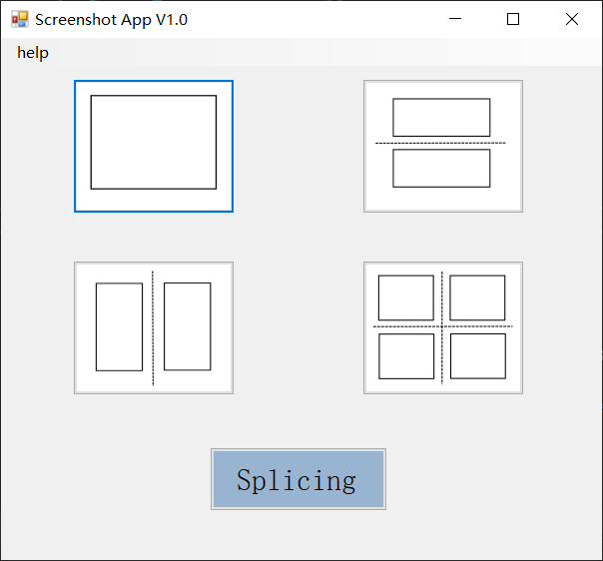
Screenshot App V1.0

Slide 2
Software business flow chart
Choose a screenshot method
Whether to take only one screenshot
Y
capture a screenshot
save screenshot
startt
N
Y
Save the composite picture
Choose the pictures you want to compose
Choose splicing button
Choose a word document
Insert picture into word automatically
endt

Slide 3
Synthetic image algorithm processing
We use it
EmguCV
https://github.com/emgucv/emgucv
opencvsharp
https://github.com/shimat/opencvsharp
Aforge.NET
https://github.com/cureos/aforge
Accord.NET
https://github.com/accord-net/framework/
More information, easy to use, good synthesis effect
Poor picture synthesis
Less information, too complicated examples

Slide 4
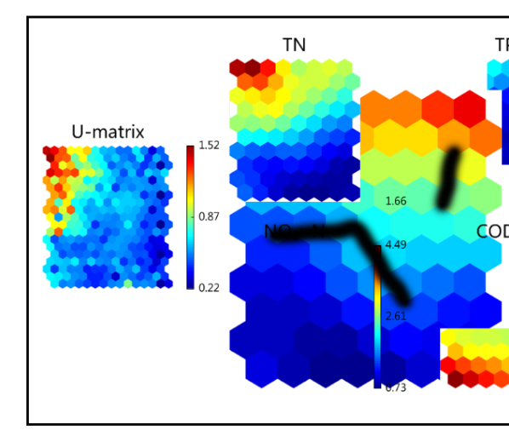
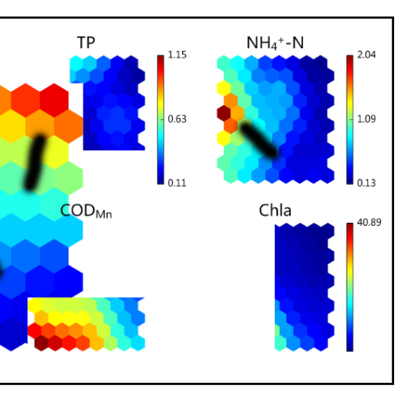
EmguCV uses Harris algorithm to match the feature points of the two pictures, and carries out synthesis operation

Slide 5
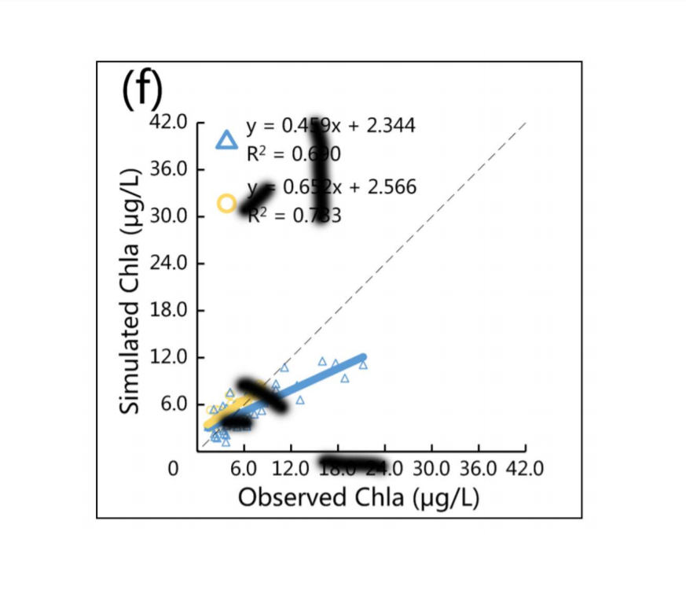
Detect and remove black borders
From the middle of the four sides of the picture use getPixel() method to detect the distance from the black border to the border
Use the setPixel() method to set the black frame to white based on the four distances

Slide 6
Introduction to software use
Choose a screenshot mode according to your needs
After pulling out a rectangle with the left mouse button, click twice in the rectangle with the left mouse button to complete the screenshot
Right click to cancel this screenshot and exit

Slide 7
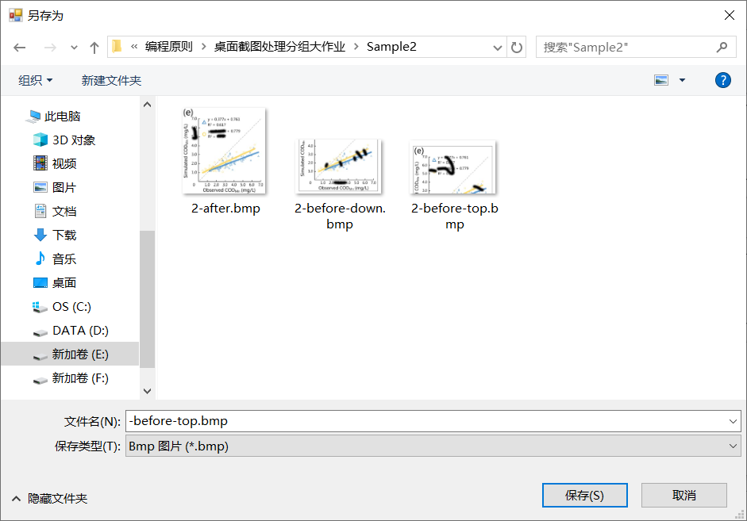
Introduction to software use
Save dialog box will pop up after every screenshot
File suffixes are generated automatically, such as”-before-top”,”-before-down”,”-after”
The user just needs to fill in the name of the file at the beginning
Auto generate

Slide 8
Introduction to software use
Click the splicing button to select the picture you want to compose

Slide 9
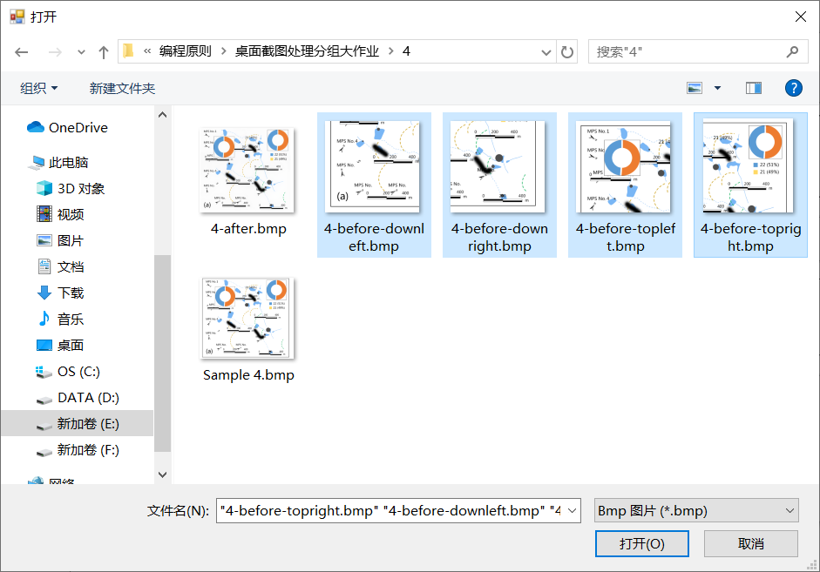
Introduction to software use
Select the pictures you need to synthesize (you can select all at once)
The program will automatically match the composition algorithm according to the number and file name you choose

Slide 10
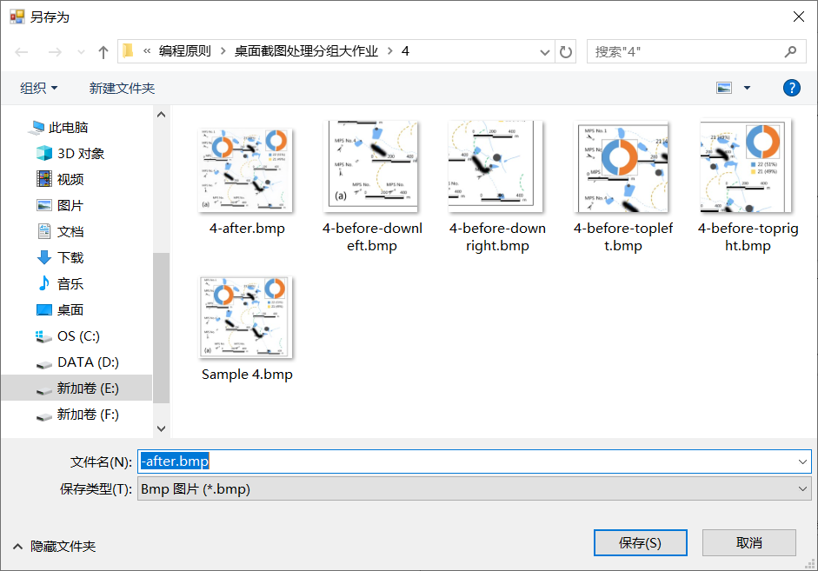
Introduction to software use
After waiting for a few seconds for the event, the saved dialog box will pop up
Similarly, the suffix of the file is “- after.bmp ”It‘s also generated automatically.
Auto generate

Slide 11
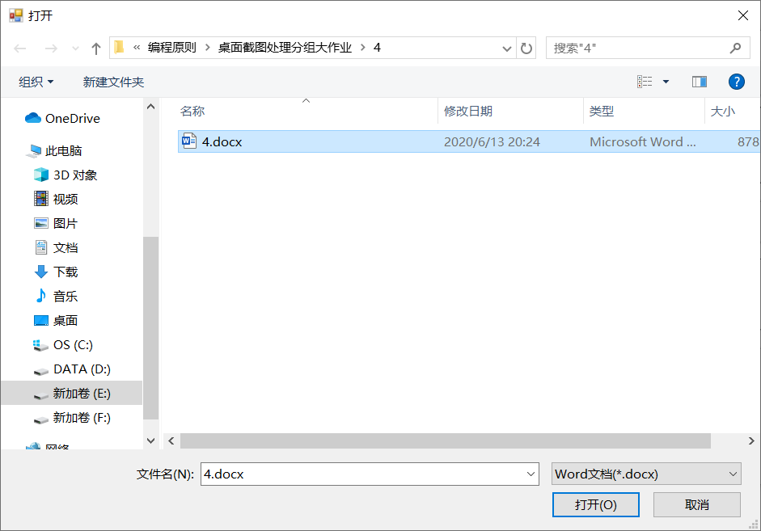
Introduction to software use
After the picture is saved successfully, another dialog box for selecting files will pop up
Select an existing word file, the program will automatically open the word document, insert the BMP picture into word, and then save and close word

Slide 12
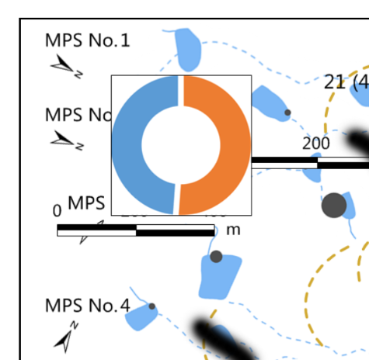
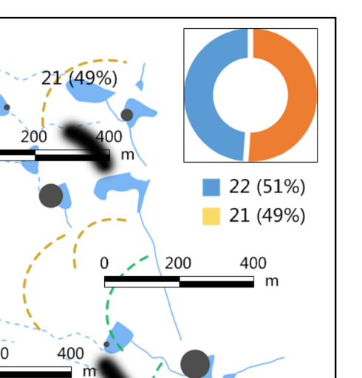
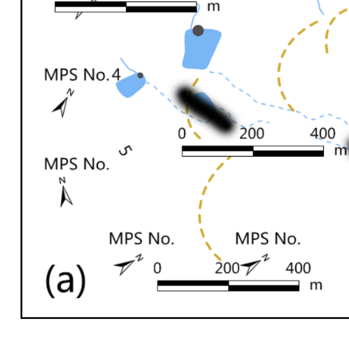
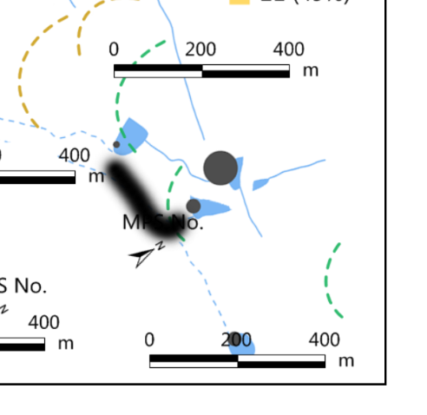
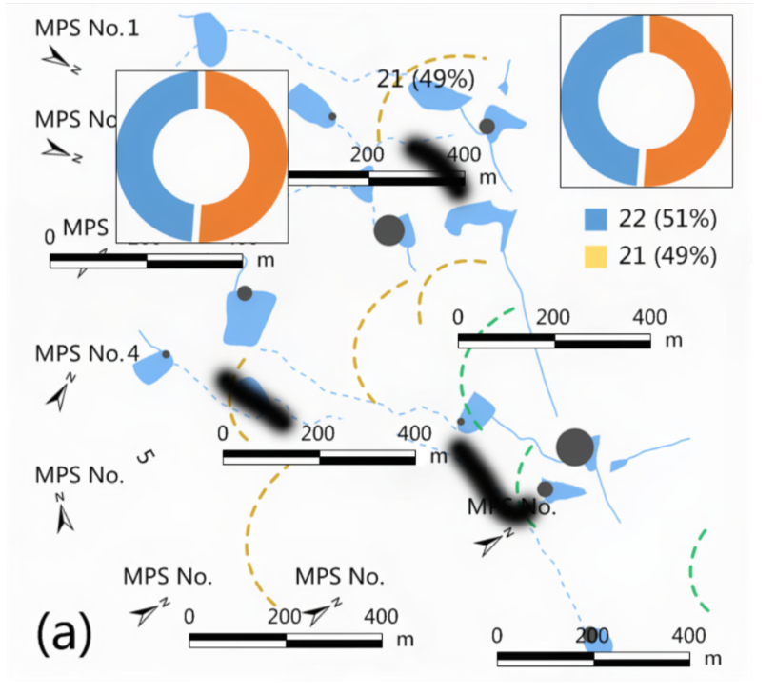
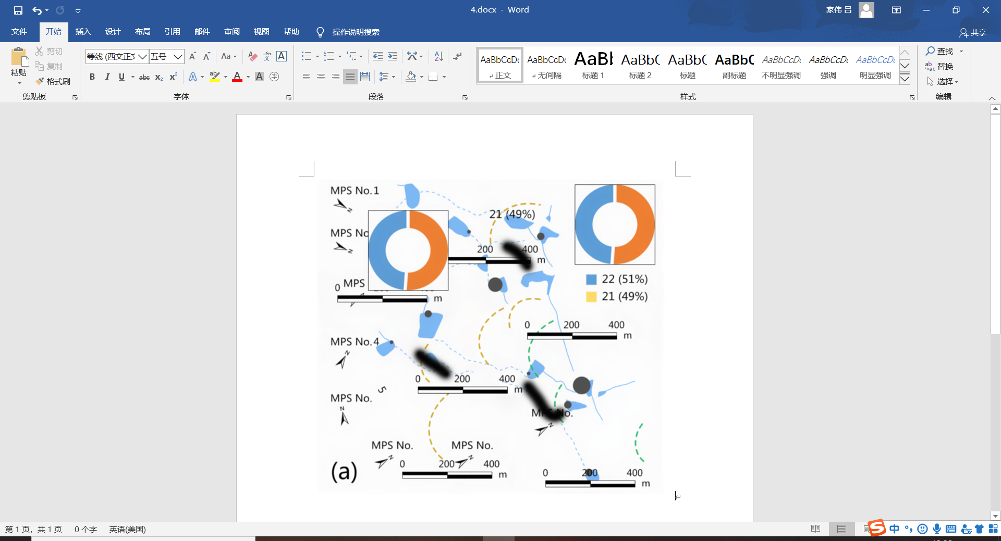
Complete effect
4-before-topleft.bmp
4-before-topright.bmp
4-before-downleft.bmp
4-before-downright.bmp
4-after.bmp
4.doc

